Slide 1
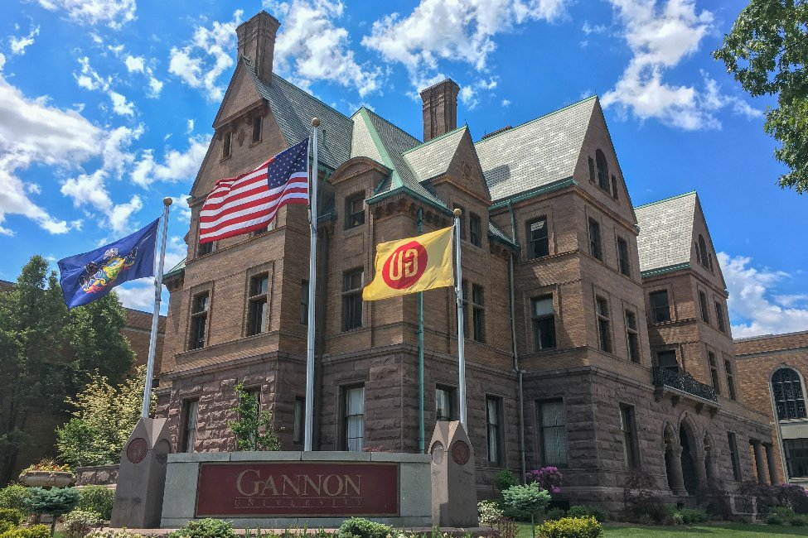
Brain Tumors Detection and Segmentation
Using Deep Learning
Karthik Bala
Data Science
Dr. Richard Matovu

Slide 2
Content
Introduction
Problem & Scope
Dataset
Classification
Image Processing
Data Augmentation
Segmentation
How it works
Model training
Testing
Timeline
Deliverables

Slide 3

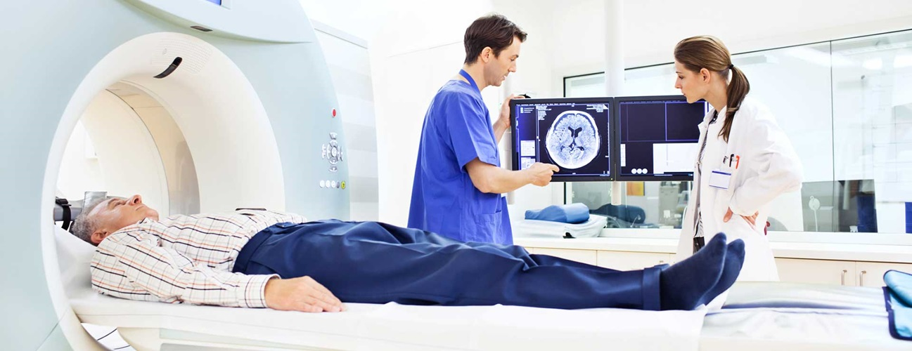
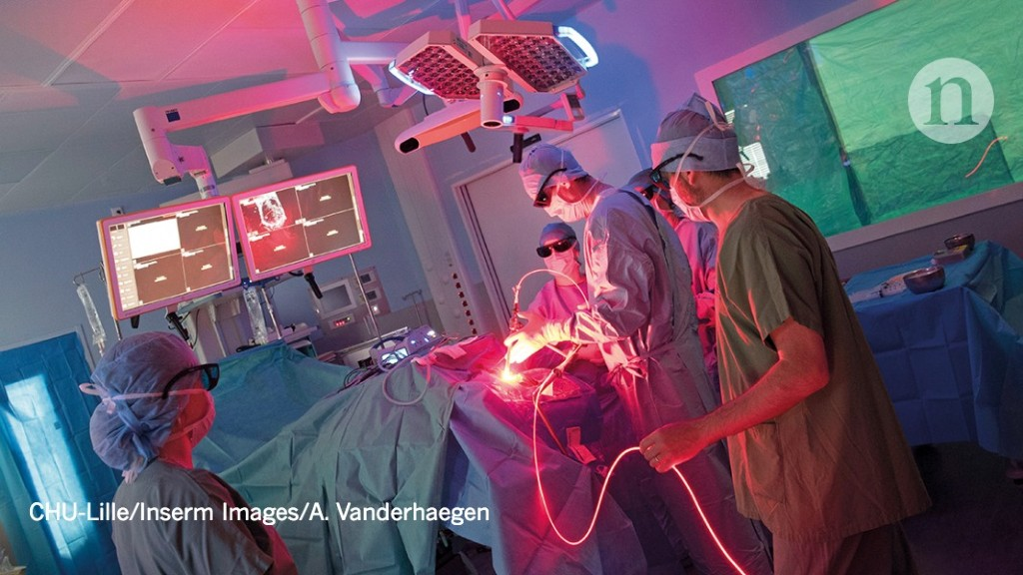
Introduction
700000 living brain tumor patients (Source: NBTS)
84,170 diagnosis in 2021
75.2% average survival rate
MRI

Slide 4
Problem & Scope
Problem
Manual delineation.
Manual Segmentation time consuming.
Variability among the radiologist on segmentation.
Scope
Build a Model (identify the tumor)
Use VGG Network to segment the tumor
Create a website that helps to Radiologist.

Slide 5
Dataset
BraTS dataset
Multi-Centric, Publicly available
Each patient Volume comprises of
Fluid Attenuated Inversion Recovery (FLAIR)
T1 weighted sequence
T2 weighted sequence
T1c post contrast sequence
Pixel level segmentation mask
Dimension of dataset is 240*240
Notes:
Your job is to convince the committee that you have done sufficient exploratory work to know how to proceed with the research or development project being proposed.

Slide 6
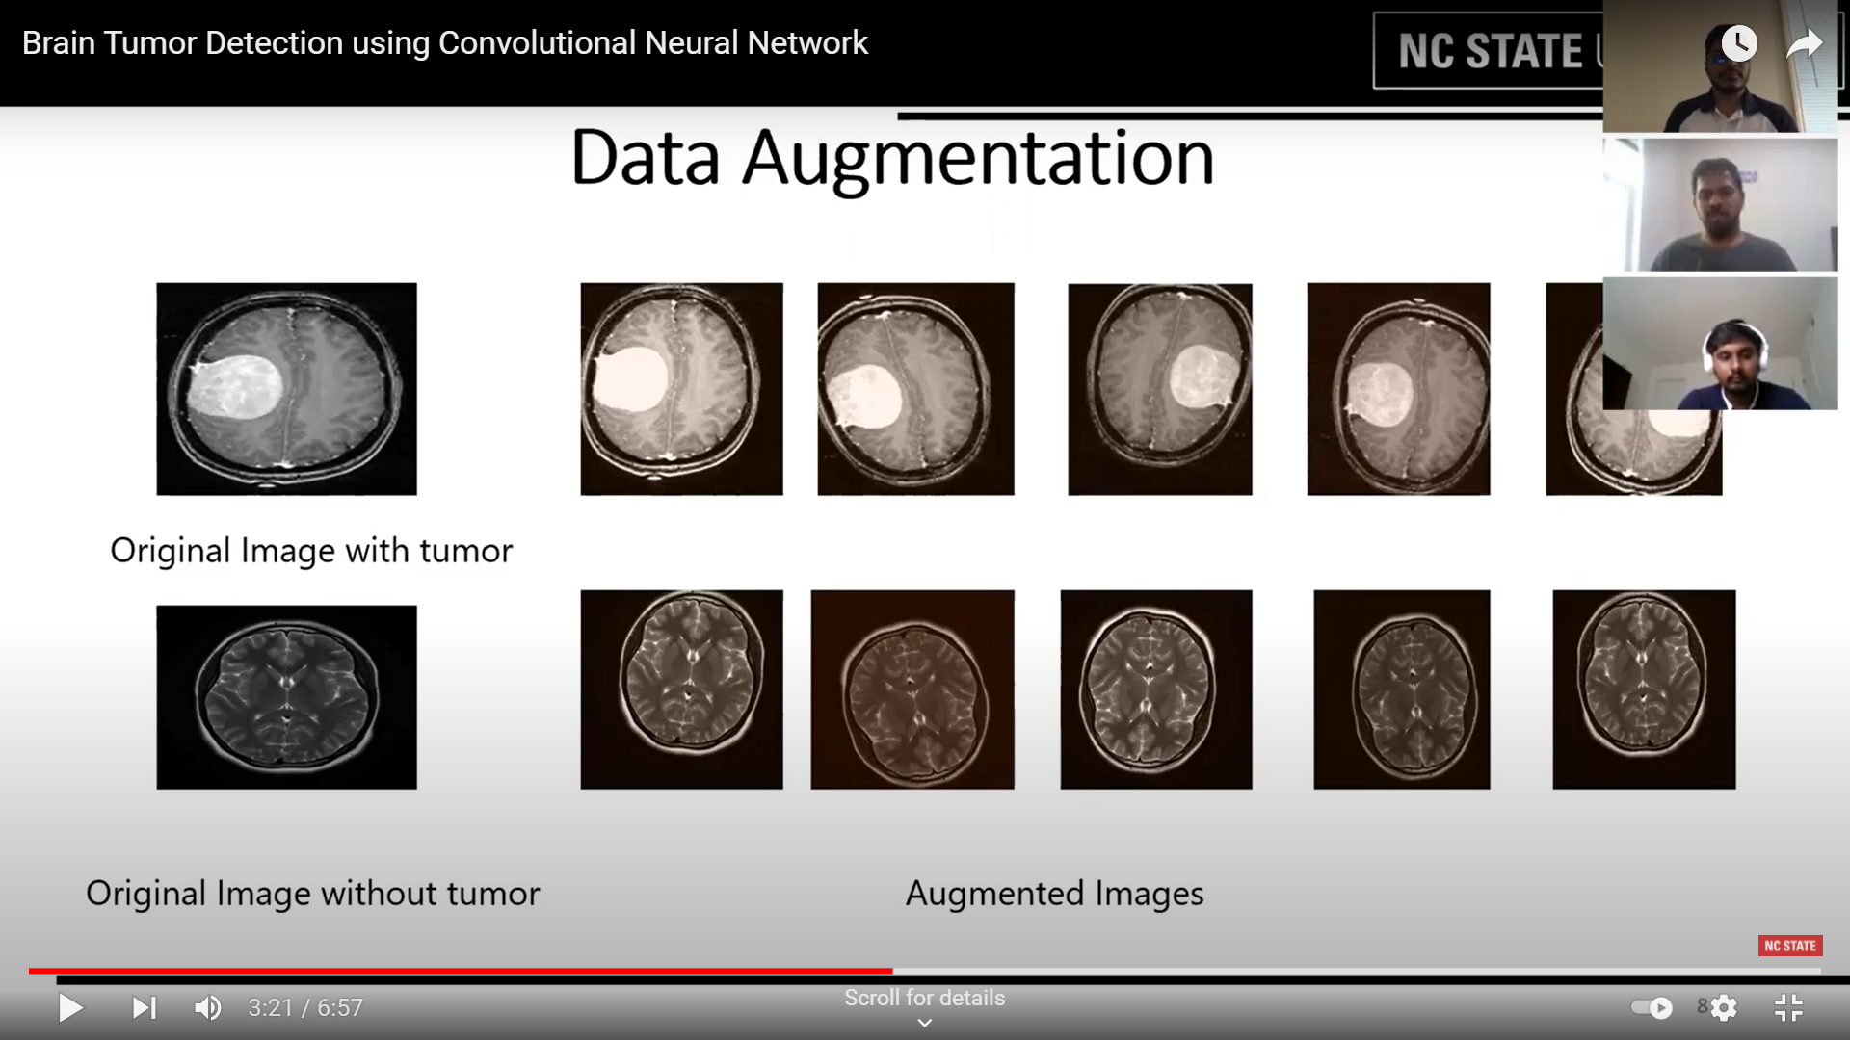
Classification: Image Processing
Image Contouring
Image Cropping
Image Resizing
Image Normalization
HoG
Input
(MRI Image)
Output
(Pre-Processed Image)
Data Augmentation
Notes:
Your job is to convince the committee that you have done sufficient exploratory work to know how to proceed with the research or development project being proposed.

Slide 7
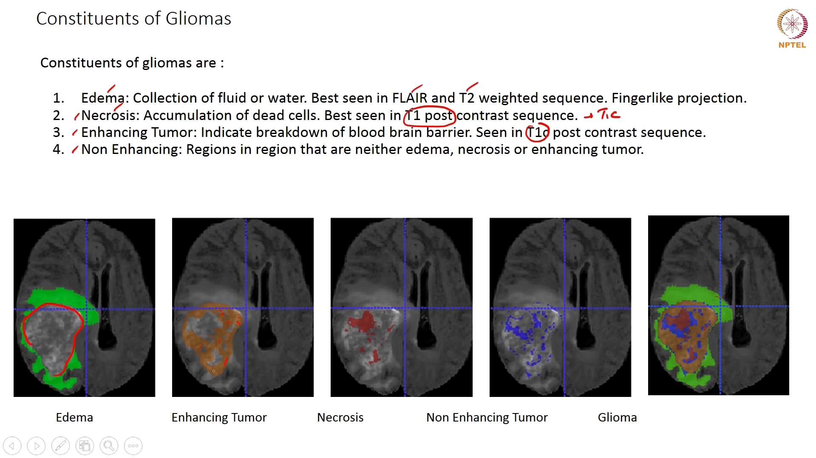
Segmentation
Edema : Collection of Fluid or water. Best seen in FLAIR and T2 weighted sequence. Fingerlike projection.
Nercosis : Accumulation of dead cells. Best seen in T1c post contract sequence.
Enhancing Tumor : Indicate breakdown of blood brain barrier. Seen in T1c Post contrast sequence.
Non Enhancing : Regions in region that are neither edema, necrosis or enhancing tumor.

Slide 8

How it Works!
Trained Model
tf Serving
Data Cleaning & Pre-processing
Model Building
Trained Model
tf dataset
CNN
Data augmentation
Website
React JS

Slide 9
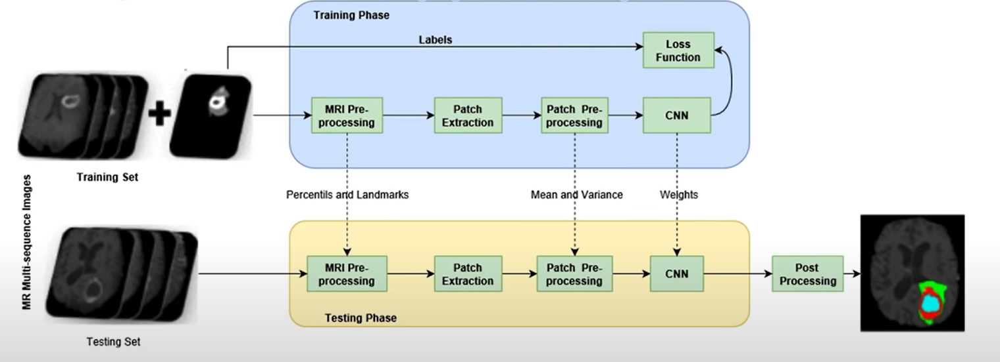
Model Training : CNN for brain tumor segmentation
CNN trained patches of MR used to predict class of centre pixel of the patch

Slide 10
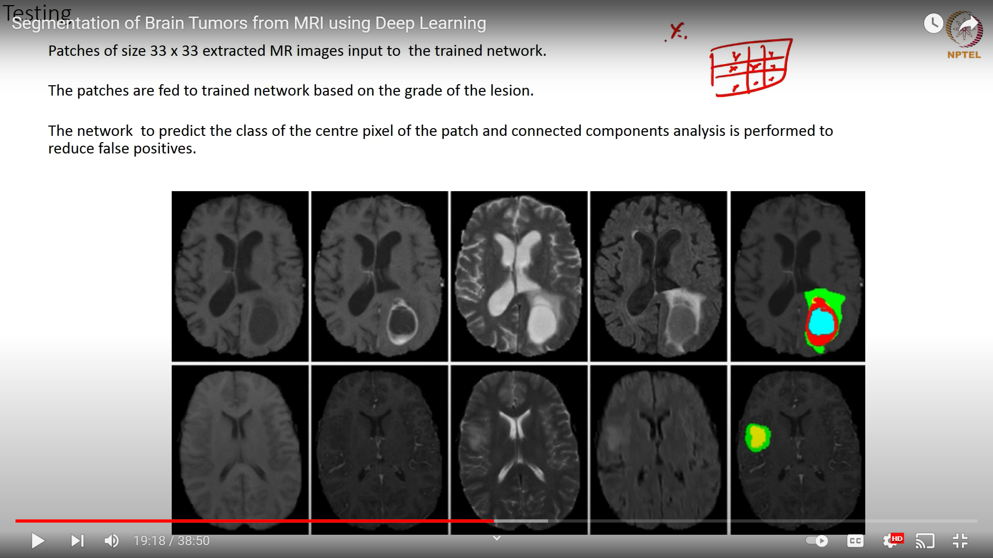
Testing
The patches are fed to trained network based on the grade of the lesion.
The network to predict the class of the centre pixel of the patch and connected components analysis is performed to reduce false positives.

Slide 11
Timeline
Project Timeline:

Slide 12
Deliverables
MR image Classification Tumor/Non-Tumor
MR image Segmentation where the tumor exactly
Website that gives classification & Segmentation

Slide 13

Notes:
Your job is to convince the committee that you have done sufficient exploratory work to know how to proceed with the research or development project being proposed.

